Slide 1
Hiring Process Analytics

Slide 2
Project Overview
Analyzing hiring process data to draw meaningful insights.
Handling missing data, combining columns, detecting and removing outliers.
Summarizing findings and visualizations.

Slide 3
Missing Data Handling
Checked for missing values in the dataset.
Removed the missing value in the Offered Salary column.

Slide 4
Outlier Detection
Calculated Interquartile Range (IQR) for Offered Salary.
Identified and handled outliers using the lower and upper bounds.
Decided to keep the outliers and analyze the impact on the overall results.

Slide 5
Hiring Analysis
The hiring process involves bringing new individuals into the organization for various roles.
My Task: Determine the gender distribution of hires. How many males and females have been hired by the company?

Slide 6
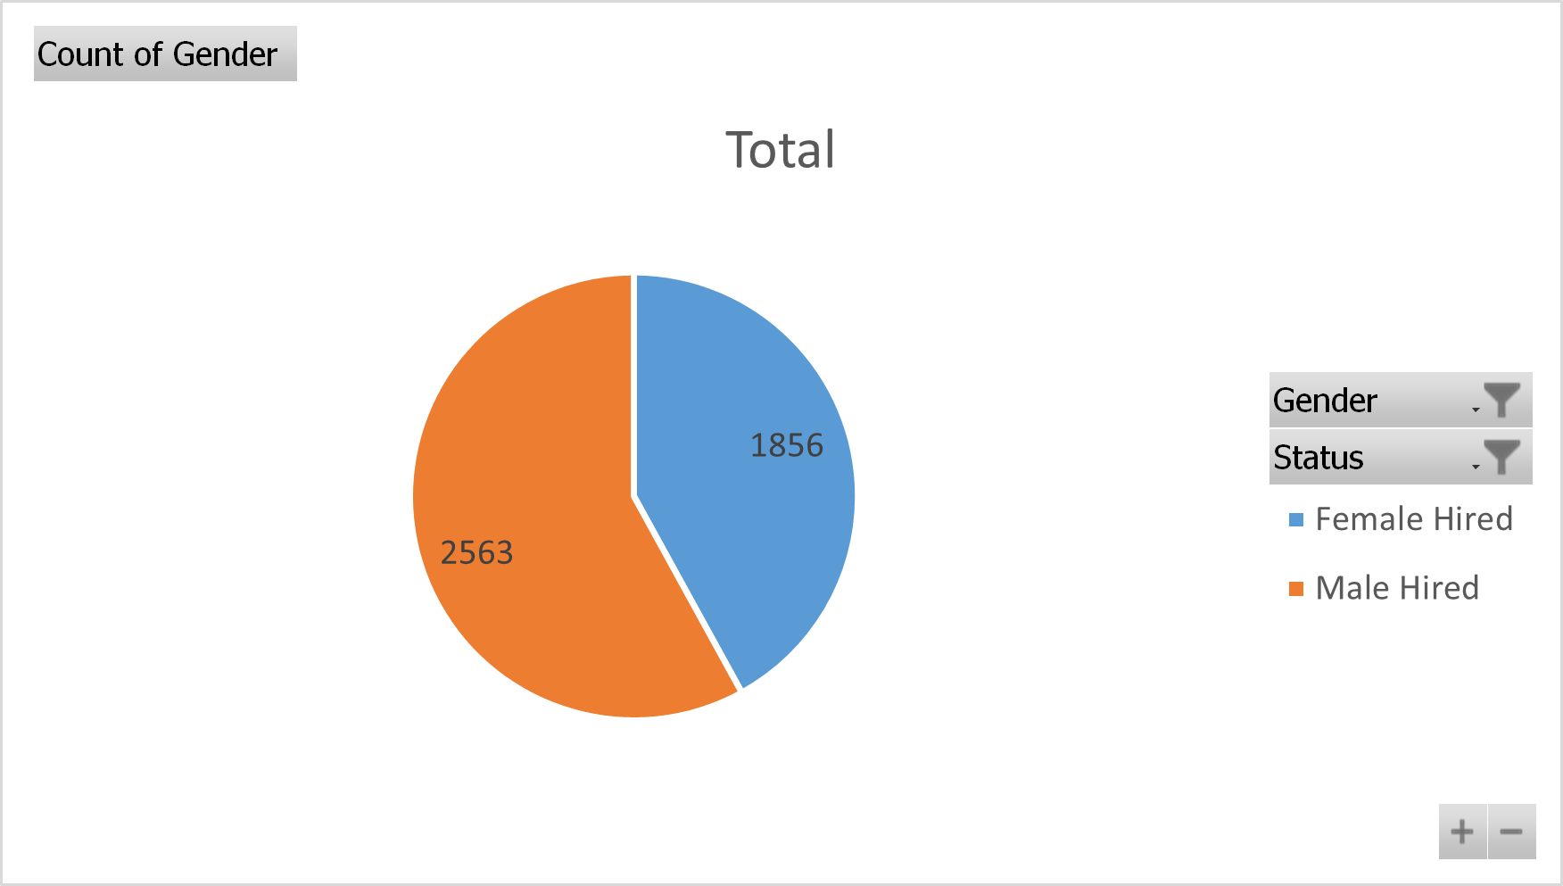
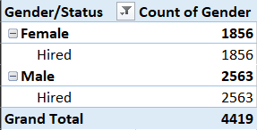
Created a pivot table to count the number of males and females hired.
Inserted a pie chart to visualize the gender distribution.
From the pie chart we can observe a total of 2563 Male and 1856 Female are hired and working in the company.

Slide 7
Average Salary
The average salary is calculated by adding up the salaries of a group of employees and then dividing the total by the number of employees.
My Task: What is the average salary offered by this company?

Slide 8
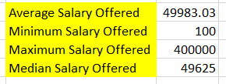
Calculated the average salary offered by the company using the AVERAGE function.
Also Found the Minimum salary, Maximum salary and Median salary offered by the company.
The AVERAGE salary offered by the company is 49983.03

Slide 9
Salary Distribution
Class intervals represent ranges of values, in this case, salary ranges. The class interval is the difference between the upper and lower limits of a class.
My Task: Create class intervals for the salaries in the company.

Slide 10
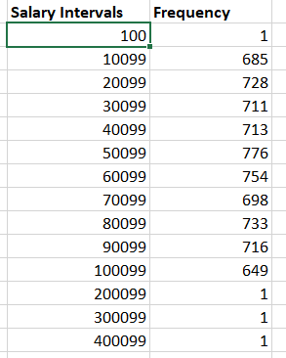
Created salary intervals (e.g., 10K, 20K, etc.).
Used the FREQUENCY function to calculate the distribution.
The Salary range of 40100-50099 is offered to 776 candidates which is the highest, including both hired and rejected candidates

Slide 11
Departmental Analysis
Visualizing data through charts and plots is a crucial part of data analysis.
My Task: Use a pie chart, bar graph, or any other suitable visualization to show the proportion of people working in different departments.

Slide 12
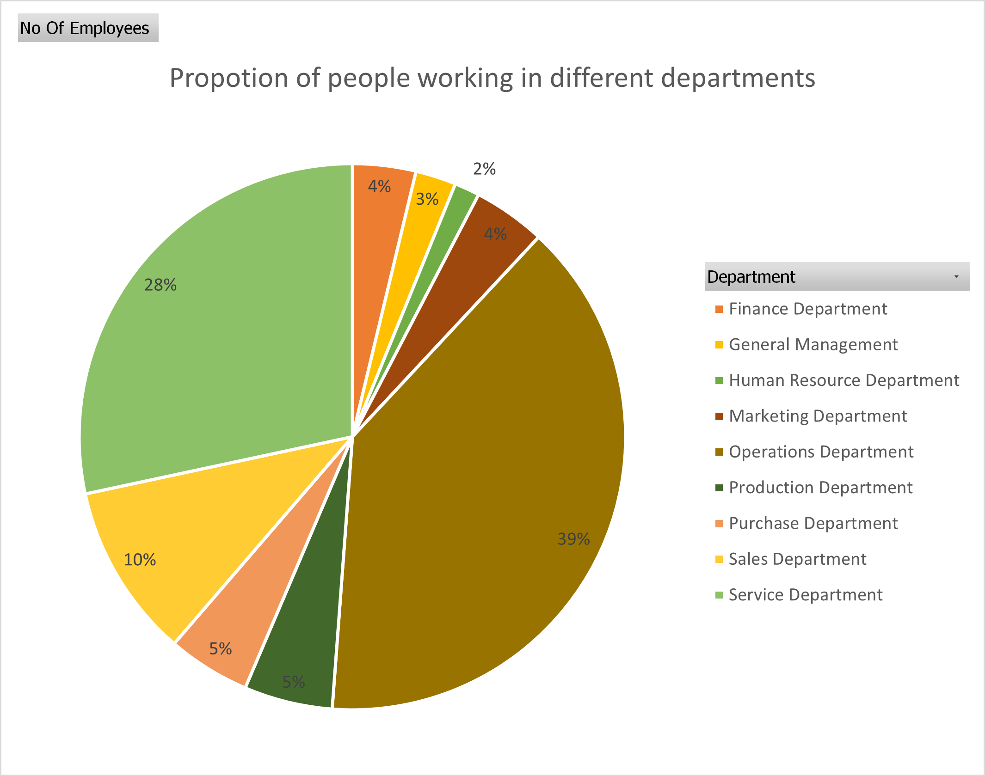
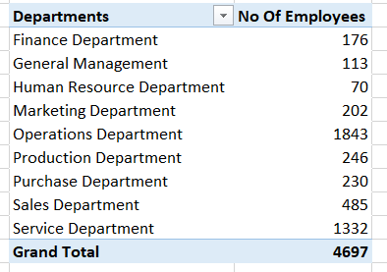
Created a pivot table to count the number of employees in each department.
Inserted a pie chart to show the proportion of people in different departments.
The OPERATIONS DEPT has highest No of Employees and HUMAN RESOURCES DEPT has lowest No of Employees.
39% of the hired employees are working in operations dept, whereas only 1% of the hired employees are working in Human resources dept

Slide 13
Position Tier Analysis
Different positions within a company often have different tiers or levels.
My Task: Use a chart or graph to represent the different position tiers within the company.

Slide 14
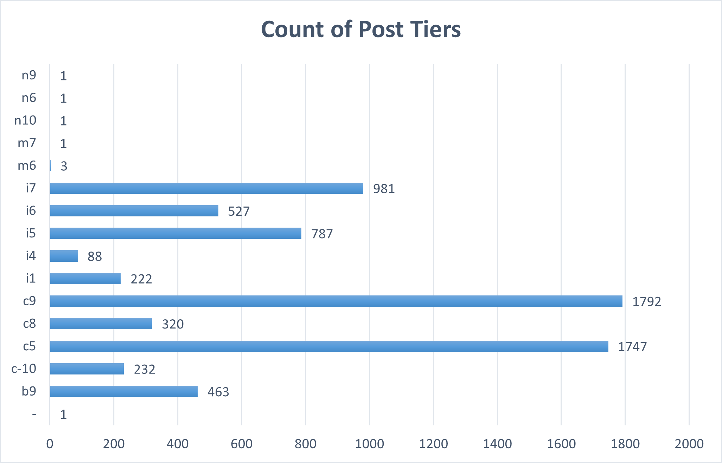
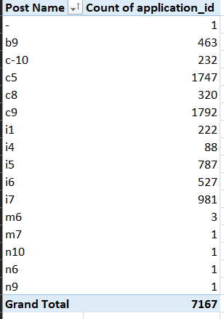
Created a pivot table to count the number of positions in each tier.
Inserted a bar chart to visualize the distribution.
From the chart we can see that 1792 people have applied for c9 post, which is 25% of total candidates applied.

Slide 15
Conclusion
Through this project, I achieved the following:
Comprehensive Data Cleaning: Addressed missing data by removing the row, ensuring a more accurate analysis.
Outlier Analysis: Identified and retained outliers to understand the impact, and providing deeper insights into salary variations.
Gender Distribution Analysis: Revealed the current gender balance among the candidates.
Salary Insights: Calculated the average salary and analyzed salary distribution.
Departmental Distribution: Analyzed employee distribution across departments, helps in strategic workforce planning.
Visualization: Created charts and graphs to visually represent important data points, making insights more accessible and actionable.

